Slide 1



CPOL Antenna and DTMF Control Capstone Senior Design Project March 17th, 2015
Tim Bodkin
Kevin Helms
Chris Tatosian
Luis Ceja Quiroz

Slide 2
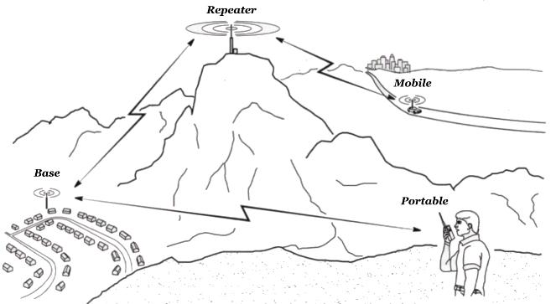
Problem Statement
Problem
Degraded signal integrity of the UCSC repeater due to local terrain
Solution
Improved reception by the addition of a circularly polarized antenna

Slide 3
Project Requirements
Circularly polarized antenna array
DTMF controller
Antenna switching circuit
RoIP nodes
Audio linking Interface

Slide 4
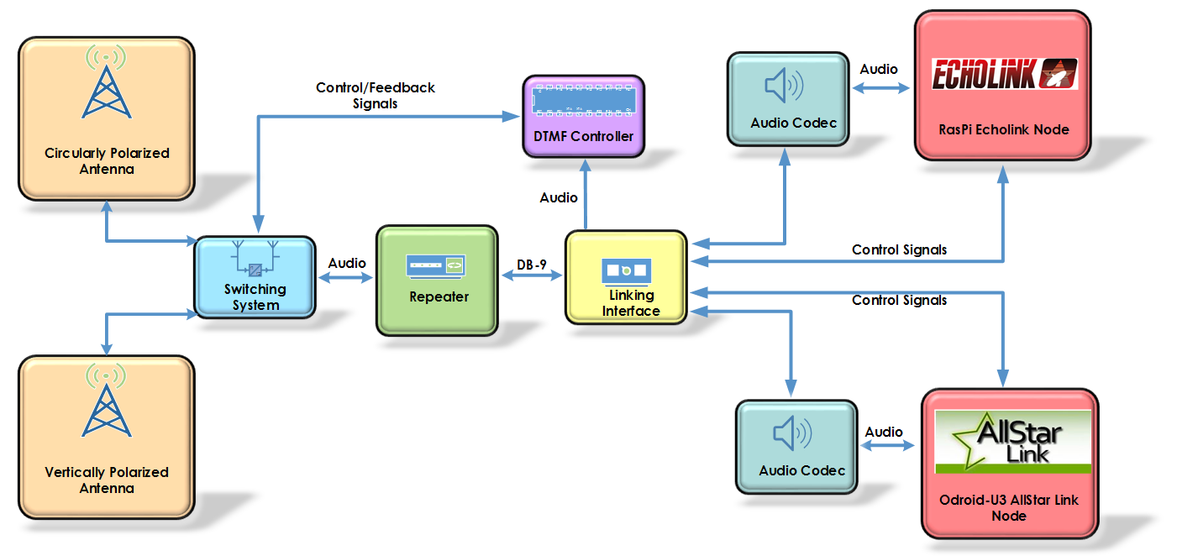

Slide 5
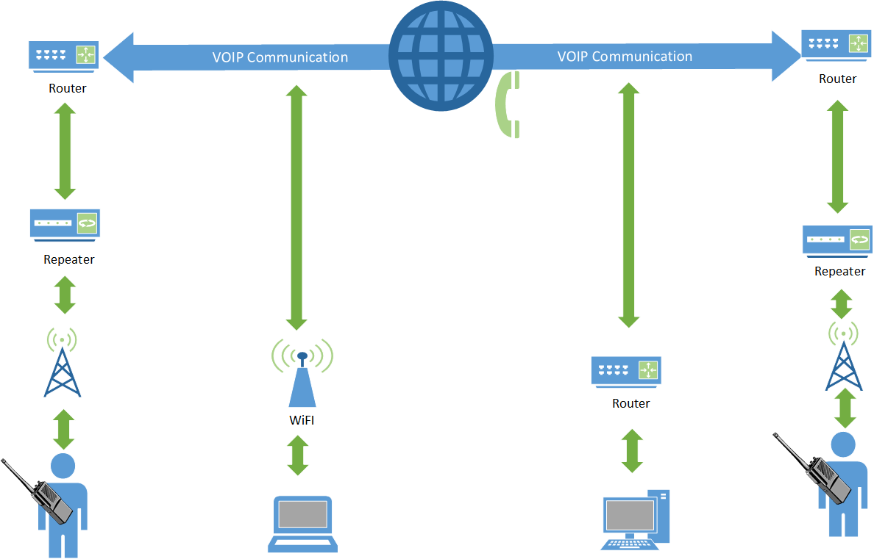

Slide 6
Antenna Switching Circuit
System that switches active antenna
Digital control and feedback signals

Slide 7
Motivation
Real time switching between antennas
Switching event through DTMF tones

Slide 8
Initial Design and Implementation
Power supply
Coaxial relays
Power MOSFETs
Two feedback signals

Slide 9
Challenges
Rectified DC voltage higher than calculations predicted
Power resistors were found to get very hot
DTMF board can’t completely tell state of switching board

Slide 10
Final Design
Added a fan to cool
Third feedback signal added

Slide 11
Results
Reliable antenna switching

Slide 12
DTMF Controller
Overview:
The DTMF Controller acts as a central control for the antenna switching system
Logic is collected and sent between this circuit and the Linking Interface as well as the Switching Circuit
Verifies DTMF sequences through hardware and switches between the VPOL and CPOL antenna upon an appropriate sequence

Slide 13
Initial Design and Implementation
Initial Design included DTMF decoder chip MT8870 and an Atmega328P
Atmega 328P provides enough GPIO ports for desired inputs, outputs, and additional pins for future work
Atmega 328P inputs are compatible with Decoder outputs
Initial design involved Pulsed inputs using AND gates

Slide 14
Challenges
Debugging
Slow Decoding
Pulsed signals had potential for timing errors, so instead designed to function with latched signals synchronous

Slide 15
Results
Final Design
Faster Decoding Time
Latched Inputs
LCD Display
Status LED’s
Manual Switch
Audible Tone

Slide 16
All Star Link Node
Overview
Odroid U3
Asterisk PBX
AllStar Link
Validated Users
Security

Slide 17
Approach and Initial Design
IRLP
Odroid U3
CM 108 Audio Codec
U3 I/O Daughter Board

Slide 18
Challenges
Processing power
Software Installation
Device Driver
Little Documentation
No Support for Odroid
UDP Port Access

Slide 19
Results

Slide 20
Echolink Overview
Open source VoIP system for amateur radio users
Originally developed for windows, but later expanded to OS X and linux
Over 200,000 validated users, about 5,000 online at any given time
Security is based on callsign validation
No known cases of malware or viruses from echolink (because it cant accept file data)

Slide 21
Echolink: Approach
Linux based single board computer (Raspberry Pi)
Software used is SVX Link, an open source VoIP software package for amatuer radio
Remote activation from field via DTMF commands
Built in DTMF decoder

Slide 22
Echolink: Initial Design
Configured in Raspbian OS
Configured static IP for SSH access on UCSC network
User interface available by SSH
Runs as a Daemon background process
Control signals configured via GPIO pins on Raspberry Pi

Slide 23
Echolink: Challenges
Controlling audio output so that both nodes can’t transmit at the same time
Cutsomization to fit our multi-node design

Slide 24
Echolink: Final Design
Event based (GPIO) Python background script controls audio output to prevent both nodes transmitting at same time
Constantly running DTMF controller Echolink node

Slide 25
Echolink: Results

Slide 26
Linking Interface Overview
Central hub for all audio going between modules (DTMF controller, VoIP nodes) and the repeater

Slide 27
Linking Interface: Approach
Audio distribution amplifier for audio going to modules
Audio summing amplifier for audio going to the repeater
Embedded logic to prevent simultaneous audio transmission to repeater from VoIP nodes

Slide 28
Linking Interface: Initial Design
3.5mm mono audio jacks for audio connections
Potentiometers (logrithmic, 10k) on audio channels going to repeater to allow for gain control on individual audio channels
If one node is transmitting audio to repeater, other VoIP node is sent a ‘mute’ signal which is interpreted via a GPIO pin on each SBC, in the event that both nodes begin transmitting at the same time, Echolink is given priority
Powered off of the same 12v supply that powers the repeater

Slide 29
Linking Interface: Challenges
Control logic on first 1st rev was over complicated and needed simplification
Mistake with power supply pins on audio amplifier led to complications with testing
The LM-2936 LDO didn’t give a steady 3.3v rail. Required additional capacitors to filter out high frequencies

Slide 30
Linking Interface: Final Design
Linking interface also provides power for the SBCs and DTMF controller
Linking interface has DTMF controller stacked on top of it as daughter board
Linking interface, DTMF controller, and SBCs are all within same casing

Slide 31
Linking Interface: Results

